Slide 1
Nondeterministic Finite Automata
Shekh. Md. Saifur Rahman
Lecturer, CSE Department
UIU

Slide 2
Nondeterminism
Nondeterminism is a useful concept that has had great impact on the theory of computation. Nondeterminism is an inessential feature of finite automata.
Every nondeterministic finite automaton is equivalent to a deterministic finite automaton.
Thus we shall profit from the powerful notation of nondeterministic finite automata.
But we always know that, if we must, we can always go back and redo everything in terms of the lower- level language of ordinary, down-to-earth deterministic automata.
Lecturer Saifur Rahman, Dept. of CSE, United International University

Slide 3
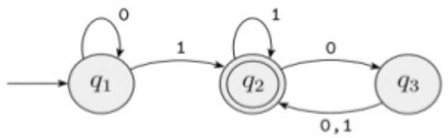
DFA vs NFA
Every state of a DFA always has exactly one exiting transition arrow for each symbol in the alphabet.
In a DFA, labels on the transition arrows are symbols from the alphabet set Σ
Lecturer Saifur Rahman, Dept. of CSE, United International University

Slide 4
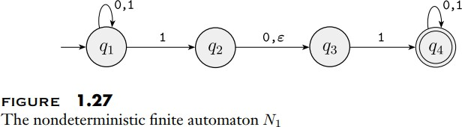
DFA vs NFA
In a nondeterministic machine, several choices may exist for the next state at any point. In an NFA, a state may have zero, one or more exiting arrows for each alphabet symbol.
In NFA, labels on the transition arrows are symbols from the alphabet or 𝜀. Zero, one or many arrows may exit from each state with the label 𝜀.
Lecturer Saifur Rahman, Dept. of CSE, United International University

Slide 5
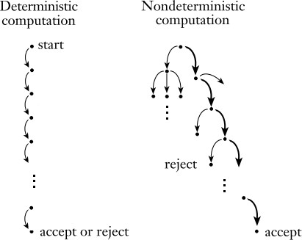
DFA vs NFA
Lecturer Saifur Rahman, Dept. of CSE, United International University

Slide 6
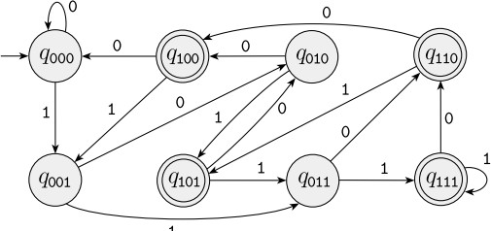
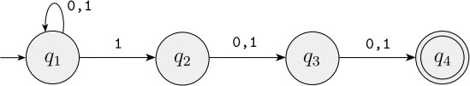
Why NFA?
DFA :
NFA :
Faster : It follows only one path.
Complex : More no of states and transitions.
Slower : It chooses between many paths
Simple : Easy to express and join multiple machines.
Language that accepts all strings over {0,1} that contain a 1 either at the third position from the end
Lecturer Saifur Rahman, Dept. of CSE, United International University

Slide 7
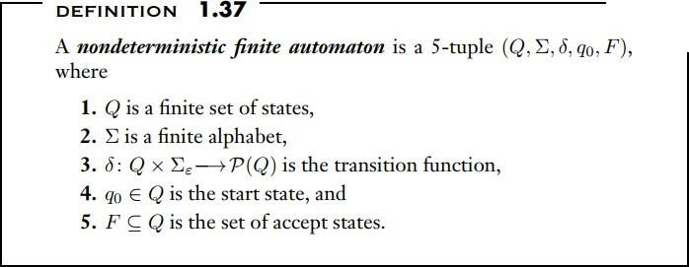
Formal Definition of NFA
Lecturer Saifur Rahman, Dept. of CSE, United International University

Slide 8
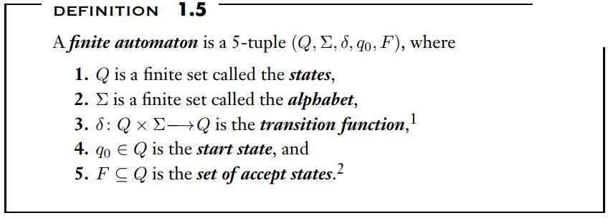
Comparison with DFA
Lecturer Saifur Rahman, Dept. of CSE, United International University

Slide 9
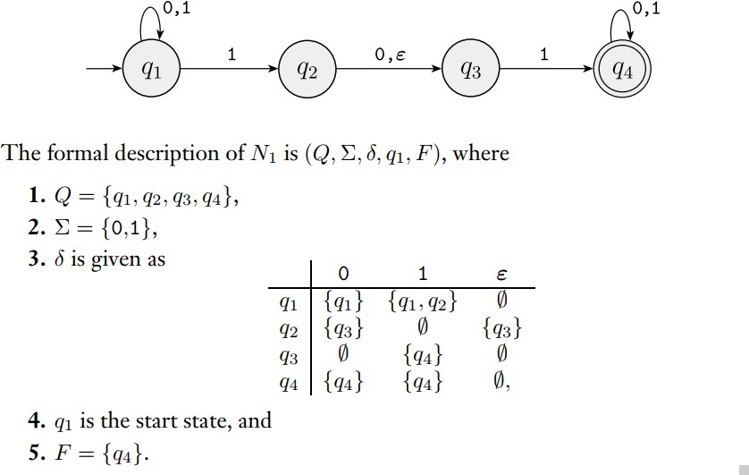
Lecturer Saifur Rahman, Dept. of CSE, United International University

Slide 10
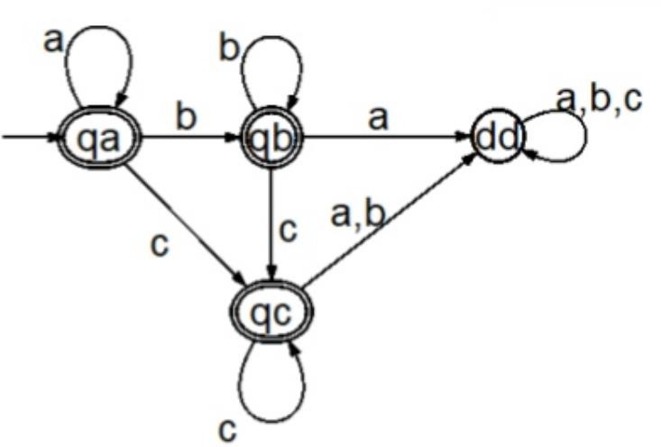
How does a DFA compute?
DFA will start from the start state, 𝑞_{𝑎}
It will take input one symbols from the input string from left to right consecutively and will traverse to the next states accordingly.
After reaching the last state when no other input symbols left, if the last state is an accept state then this machine will accept that string otherwise it can’t accept/reject that string.
Lecturer Saifur Rahman, Dept. of CSE, United International University

Slide 11
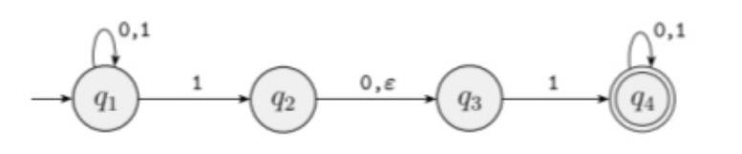
How does an NFA compute?
Suppose we are in state 𝑞₁in NFA and that the next input symbol is a 1. After reading that symbol, the machine splits into multiple copies of itself and follows all the possibilities in parallel.
Each copy of the machine takes one of the possible ways to proceed and continues as before. If there are subsequent choices, the machine splits again.
If the next input symbol doesn’t appear on any of the arrows exiting the state occupied by a copy of the machine, that copy of the machine dies, along with the branch of computation associated with it.
Finally, if any one of these copies of the machine is in an accept state at the end of the input, the NFA accepts the input string.
Lecturer Saifur Rahman, Dept. of CSE, United International University

Slide 12
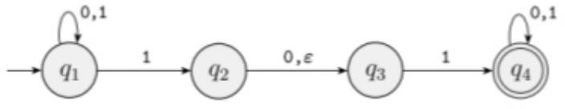
How does an NFA compute?
If a state with an 𝜀 symbol on an exiting arrow is encountered, something similar happens. Without reading any input, the machine splits into multiple copies, one following each of the exiting 𝜀 –labeled arrows and one staying at the current state.
Then the machine proceeds nondeterministically as before.
Lecturer Saifur Rahman, Dept. of CSE, United International University

Slide 13
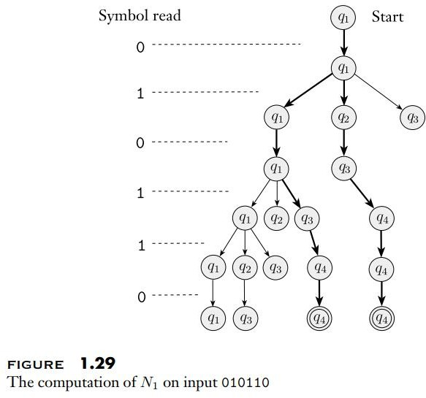
NFA Simulation Example
Lecturer Saifur Rahman, Dept. of CSE, United International University

Slide 14
Computing NFA
Let’s compute the following NFA machine for input string 010110
Lecturer Saifur Rahman, Dept. of CSE, United International University

Slide 15
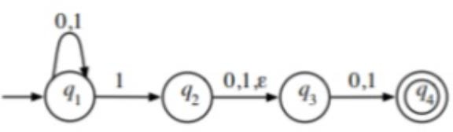
Computing NFA
Let’s compute the following NFA machine for input string 010110
Lecturer Saifur Rahman, Dept. of CSE, United International University

Slide 16
Example-2
Design an NFA with ∑ = {0, 1} accepts all string ending with 01.
Lecturer Saifur Rahman, Dept. of CSE, United International University

Slide 17
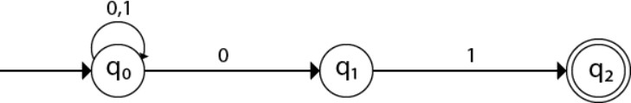
Example-2
Design an NFA with ∑ = {0, 1} accepts all string ending with 01.
Lecturer Saifur Rahman, Dept. of CSE, United International University

Slide 18
Example-3
Design an NFA with ∑ = {0, 1} in which double '1' is followed by double '0'.
Lecturer Saifur Rahman, Dept. of CSE, United International University

Slide 19
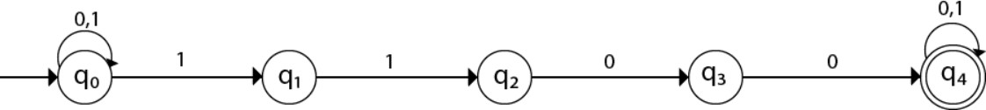
Example-3
Design an NFA with ∑ = {0, 1} in which double '1' is followed by double '0'.
Lecturer Saifur Rahman, Dept. of CSE, United International University

Slide 20
Example-4
Job of this automaton is to accept all and only the strings of 0’s and 1’s that end in 01.
Lecturer Saifur Rahman, Dept. of CSE, United International University

Slide 21

Example-4
Job of this automaton is to accept all and only the strings of 0’s and 1’s that end in 01.
Lecturer Saifur Rahman, Dept. of CSE, United International University

Slide 22
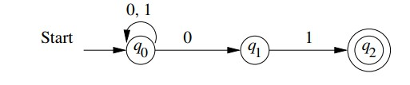
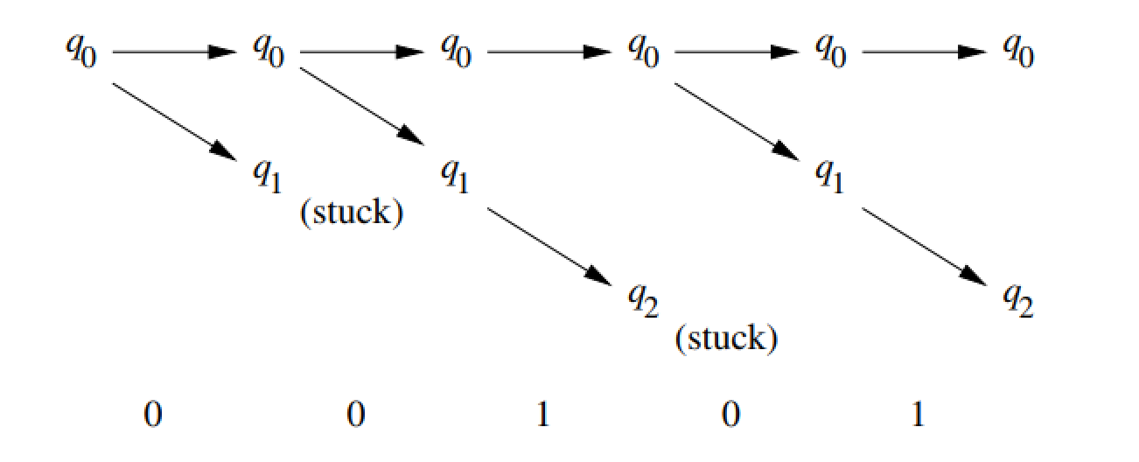
Simulating 00101 in the automata
Lecturer Saifur Rahman, Dept. of CSE, United International University

Slide 23
Example-5
Design a Ꞓ-NFA that accepts all strings of the form 0^{k} where k is a multiple of 2 or 3. accepts the strings , 00, 000, 0000, and 000000, but
not 0 or 00000
Lecturer Saifur Rahman, Dept. of CSE, United International University

Slide 24
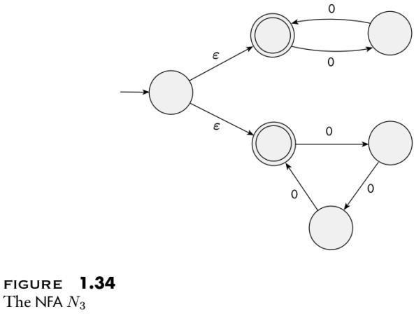
Example-5
Design a Ꞓ-NFA that accepts all strings of the form 0^{k} where k is a multiple of 2 or 3. accepts the strings , 00, 000, 0000, and 000000, but
not 0 or 00000
Lecturer Saifur Rahman, Dept. of CSE, United International University

Slide 25
Exercise
NFA – Design Draw the state diagram of NFA machines that can recognize the following languages:
L(M) = { w | w begins with 101 } over ∑={0,1} L(M) = { w | w begins with abb } over ∑={a,b} L(M) = { w | w ends with 101 } over ∑={0,1} L(M) = { w | w ends with aa } over ∑={a,b}
L(M) = { w | w contains 110 as substring } over ∑={0,1}
L(M) = { w | w contains abb as substring } over ∑={a,b} L(M) = { w | w is exactly 101 }
L(M) = { w | w contains a 1 in the 3rd position from the end } over ∑={0,1}
Lecturer Saifur Rahman, Dept. of CSE, United International University

Slide 26
Regular Operations on NFA
UNION:
The class of regular languages is closed under the union operation.
That means, if 𝐴₁ and 𝐴₂ are regular languages, then 𝐴₁U 𝐴₂ is also a regular language. Here,
𝐴₁U 𝐴₂= { x | x 𝜖 𝐴₁ or x 𝜖 A2 }
Example: 𝐴₁= { good, bad } and 𝐴₂ = { boy, girl }
Then, 𝐴₁ U 𝐴₂= { good, bad, boy, girl }.
In this case, if 𝑁₁ and 𝑁₂ represent the NFAs to recognize 𝐴₁ and 𝐴₂ then we need to build a machine N from 𝑁₁ and 𝑁₂ so that N can also recognize 𝐴₁ U 𝐴₂.
Lecturer Saifur Rahman, Dept. of CSE, United International University

Slide 27
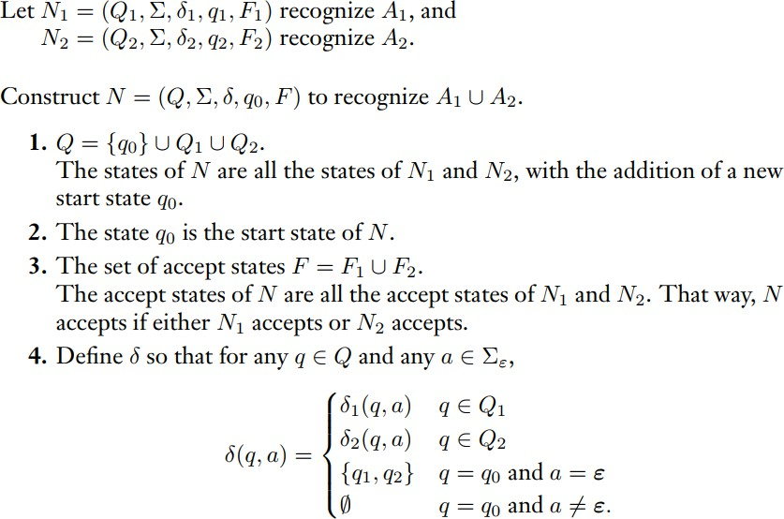
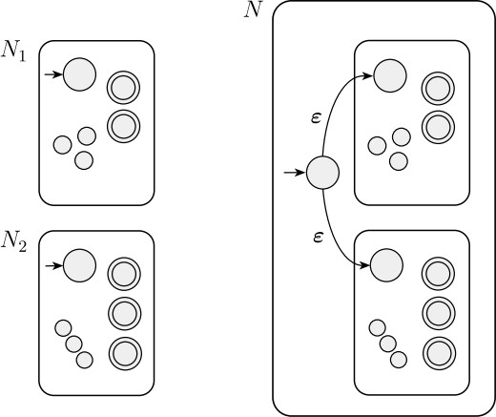
Lecturer Saifur Rahman, Dept. of CSE, United International University

Slide 28
Regular Operations on NFA
Concatenation:
The class of regular languages is closed under the concatenation operation.
That means, if 𝐴₁ and 𝐴₂ are regular languages, then 𝐴₁o 𝐴₂ is also a regular language. Here, 𝐴₁o 𝐴₂=
{ xy | x 𝜖 𝐴₁ and y 𝜖 𝐴₂}
Example: 𝐴₁= { good, bad } and 𝐴₂ = { boy, girl }
Then, 𝐴₁o 𝐴₂= { goodboy, goodgirl, badboy, badgirl }.
In this case, if 𝑁₁ and 𝑁₂ represent the NFAs to recognize 𝐴₁ and 𝐴₂ then we need to build a machine N from 𝑁₁ and 𝑁₂ so that N can also recognize 𝐴₁o 𝐴₂
Lecturer Saifur Rahman, Dept. of CSE, United International University

Slide 29
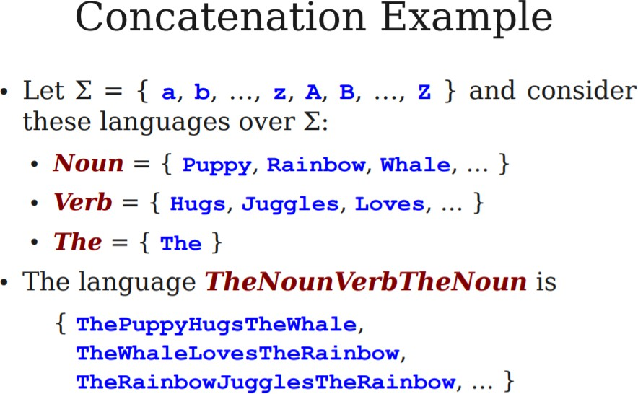
Lecturer Saifur Rahman, Dept. of CSE, United International University

Slide 30
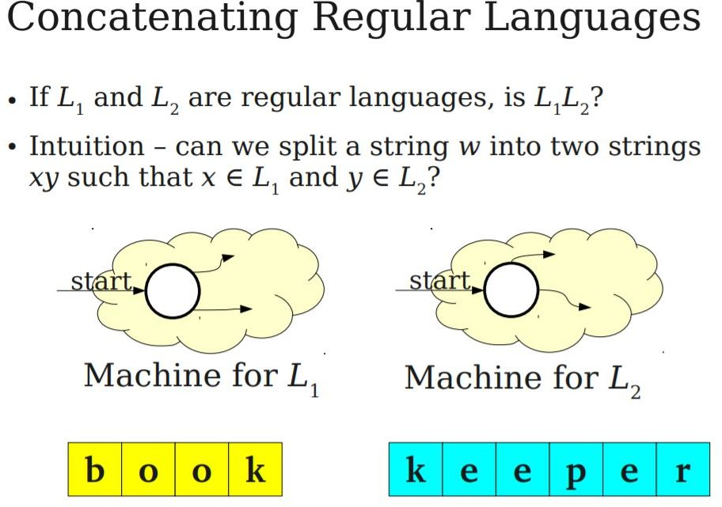
Lecturer Saifur Rahman, Dept. of CSE, United International University

Slide 31
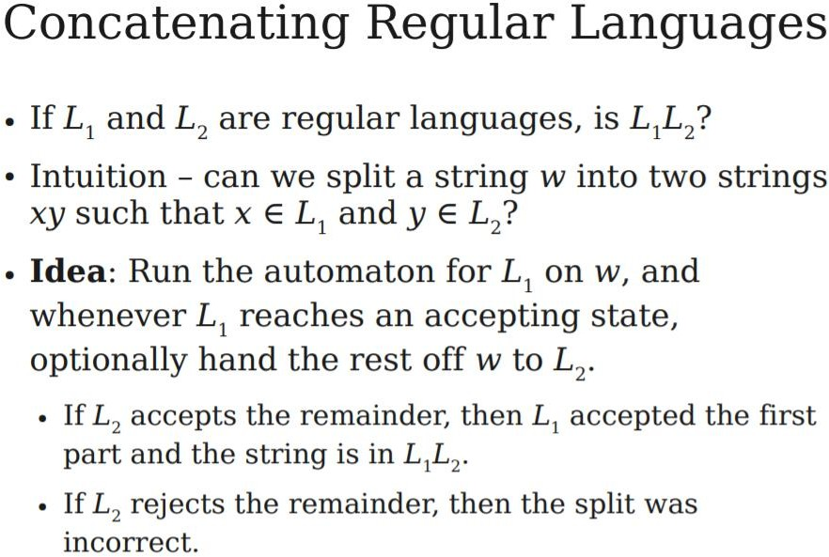
Lecturer Saifur Rahman, Dept. of CSE, United International University

Slide 32
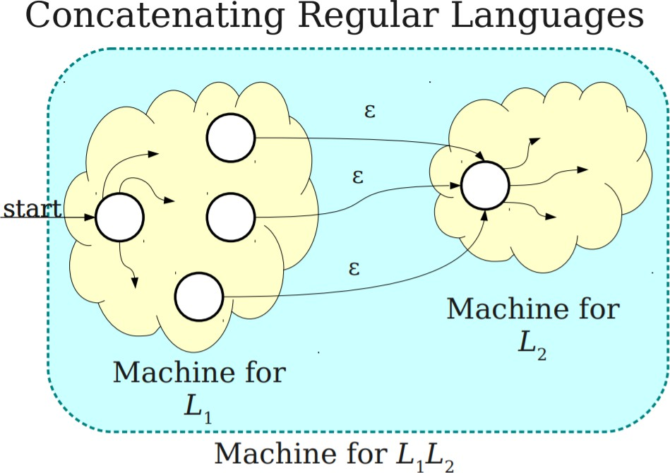
Lecturer Saifur Rahman, Dept. of CSE, United International University

Slide 33
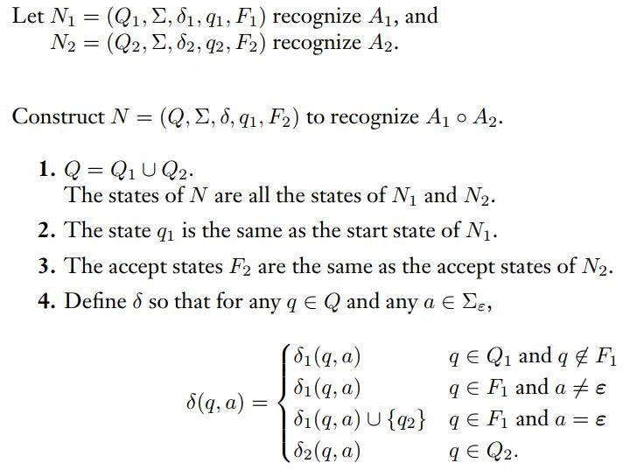
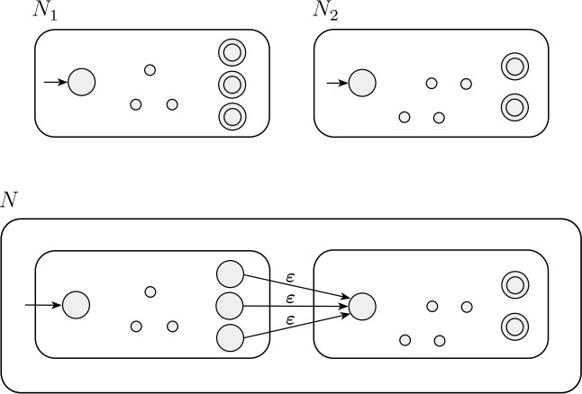
Concatenation
Lecturer Saifur Rahman, Dept. of CSE, United International University

Slide 34
Regular Operations on NFA
Star:
The class of regular languages is closed under the star operation.
That means, if 𝐴₁ is a regular language, then 𝐴₁* is also a regular language. Here, 𝐴₁* =
{𝑥₁𝑥₂𝑥₃ … … … 𝑥_{𝑘}| k>=0 and each 𝑥_{𝑖} 𝜖 𝐴₁ }
Example: 𝐴₁= { good, bad }
Then, 𝐴₁* = { 𝜀 , good, bad, goodgood, goodbad, badgood, badbad, goodgoodgood,
goodgoodbad, goodbadgood, goodbadbad, … … } .
In this case, if 𝑁₁ represent the NFA to recognize 𝐴₁ then we need to build a machine N from 𝑁₁ so that N can also recognize 𝐴₁*
Lecturer Saifur Rahman, Dept. of CSE, United International University

Slide 35
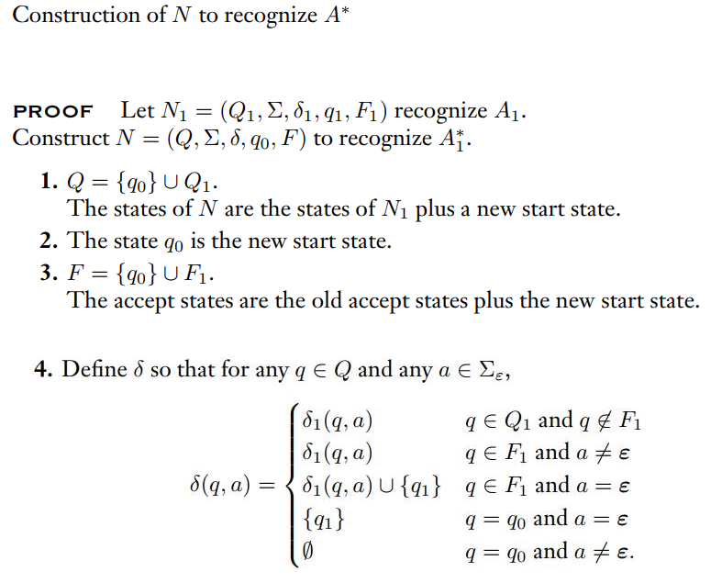
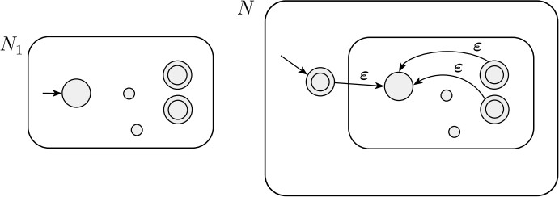
Kleene Star
Lecturer Saifur Rahman, Dept. of CSE, United International University

Slide 36
NFA Design
Design Draw the state diagram of NFA machines that can recognize the following languages:
Union: A be the language consisting of all strings of the form 0^k over {0} where k is a multiple
of 2 or 3
Union: All strings beginning with 101 or with 110
Concatenation: All strings beginning with 101 and ending with 101
Star: All strings consisting of 0 or more repetitions of 101
Plus: All strings consisting of 1 or more repetitions of 101
Complement: All strings that doesn't contain substring 101
Concat + Complement: All strings with exactly 1 occurrence of 101
Lecturer Saifur Rahman, Dept. of CSE, United International University

Slide 37
Equivalence of NFA and DFA
Deterministic and nondeterministic finite automata recognize the same class of languages. Such equivalence is both surprising and useful.
It is surprising because NFAs appear to have more power than DFAs, so we might expect that NFAs recognize more languages.
It is useful because describing an NFA for a given language sometimes is much easier than describing a DFA for that language.
Say that two machines are equivalent if they recognize the same language.
Lecturer Saifur Rahman, Dept. of CSE, United International University

Slide 38

Equivalence of NFA and DFA
Lecturer Saifur Rahman, Dept. of CSE, United International University

Slide 39
Equivalence of NFA and DFA
If a language is recognized by an NFA, then we must show the existence of a DFA that also recognizes it.
The idea is to convert the NFA into an equivalent DFA that simulates the NFA.
Recall the “reader as automaton” strategy for designing finite automata.
Lecturer Saifur Rahman, Dept. of CSE, United International University

Slide 40
Equivalence of NFA and DFA
How would you simulate the NFA if you were pretending to be a DFA?
What do you need to keep track of as the input string is processed?
In the examples of NFA’s, you kept track of the various branches of the computation by placing a finger on each state that could be active at given points in the input.
You updated the simulation by moving, adding, and removing fingers according to the way the NFA operates. All you needed to keep track of was the set of states having fingers on them.
Lecturer Saifur Rahman, Dept. of CSE, United International University

Slide 41
Equivalence of NFA and DFA
If k is the number of states of the NFA, it has 2^{𝑘} subsets of states.
Each subset corresponds to one of the possibilities that the DFA must remember, so the DFA simulating the NFA will have 2^{𝑘} states.
Now we need to figure out which will be the start state and accept states of the DFA.
What will be its transition function?
We can discuss this more easily after setting up some formal notation.
Lecturer Saifur Rahman, Dept. of CSE, United International University

Slide 42
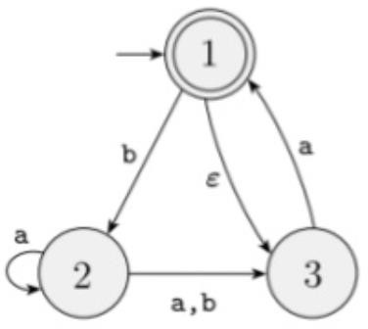
Converting NFA into Equivalent DFA
Let N = (Q, Σ , 𝛿, 𝑞₀, F) be the NFA recognizing some language A.
We need to construct a DFA machine M = (Q’, Σ , 𝛿′, 𝑞₀’, F’) recognizing A.
Lecturer Saifur Rahman, Dept. of CSE, United International University

Slide 43
Q’ = P(Q)
Every state of M is a set of states of N. Recall that P(Q) is the set of subsets of Q.
Q’ = P(Q) = set of all subsets of Q = { ∅ , {1}, {2}, {3}, {1,2}, {1,3}, {2,3}, {1,2,3} }
Lecturer Saifur Rahman, Dept. of CSE, United International University

Slide 44
𝜀 - closure
To discuss the further steps, we need to consider the ε arrows. For any state R of M, we define E(R) to be the collection of
states that can be reached from members of R by going only along ε arrows, including the members of R themselves.
For R ⊆ Q, 𝜀 - closure of R = E(R) = { q | q can be reached from members of R by traveling along 0 or more 𝜀 arrows }
Lecturer Saifur Rahman, Dept. of CSE, United International University

Slide 45
Start State, 𝑞₀’
𝑞₀’ = E (q0) = E( {1} ) = 𝜀 - closure of {1} = { 1, 3 } is our start state.
Lecturer Saifur Rahman, Dept. of CSE, United International University

Slide 46
Final State, F’
F’ = { R ∈ Q’ | R contains an accept state of N } i.e. the machine M accepts if one of the possible states that N could be in at this point is an accept state.
For this case, F’ = { {1}, {1,2}, {1,3}, {1,2,3} }
Lecturer Saifur Rahman, Dept. of CSE, United International University

Slide 47
Transition Function, 𝛿’( R, a)
For R ⊆ Q, 𝜀 - closure of R = E(R) = { q | q can be reached from members of R by traveling along 0 or more 𝜀 arrows }
For input symbol a, the transition function can be defined as,
δ’(R; a) = {q ∈ Q | q ∈ E( 𝛿(R, a) ) for some r ∈ R } = ∪_{r ∈ R} 𝛿(R, a).
In our case for example,
𝛿’( R, a) = 𝛿’( { 2, 3 } , a) = E( 𝛿( 2 , 𝑎)) U E( 𝛿( 3 , 𝑎)) = E( {2, 3} ) U E( {1} ) = {2, 3} U { 1, 3 } = { 1, 2, 3 }
𝛿’( R, a) = 𝛿’( { 1, 2 } , a) = E( 𝛿( 1 , 𝑎)) U E( 𝛿( 2 , 𝑎)) = E( { } ) U E( {2, 3} ) = { } U { 2, 3 } = { 2, 3 }
𝛿’( R, a) = 𝛿’( { 3 } , a ) = E( 𝛿( 3 , 𝑎)) = E( { 1 } ) = {1, 3}
𝛿’( R, a) = 𝛿’( { 3 } , b) = E( 𝛿( 3 , 𝑏)) = E( { } ) = { }
Lecturer Saifur Rahman, Dept. of CSE, United International University

Slide 48
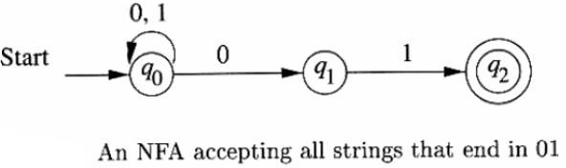
Example
Lecturer Saifur Rahman, Dept. of CSE, United International University

Slide 49
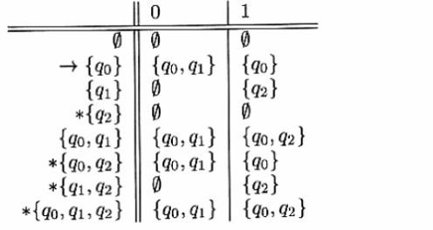
Example - Continued
Complete subset construction and transition table
Lecturer Saifur Rahman, Dept. of CSE, United International University

Slide 50
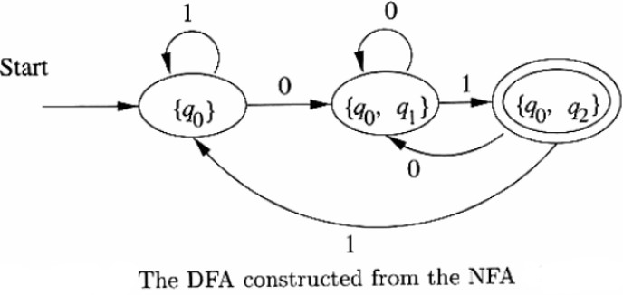
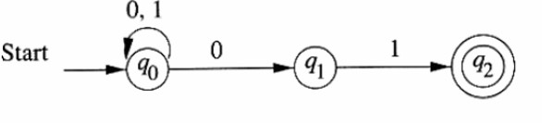
Example - Continued
Lecturer Saifur Rahman, Dept. of CSE, United International University

Slide 51
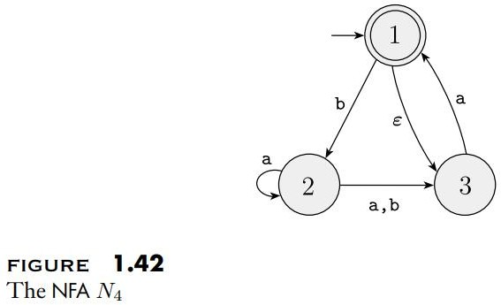
Another Example
Lecturer Saifur Rahman, Dept. of CSE, United International University

Slide 52
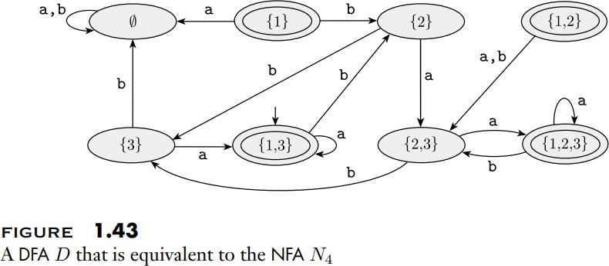
Solved?
Lecturer Saifur Rahman, Dept. of CSE, United International University

Slide 53
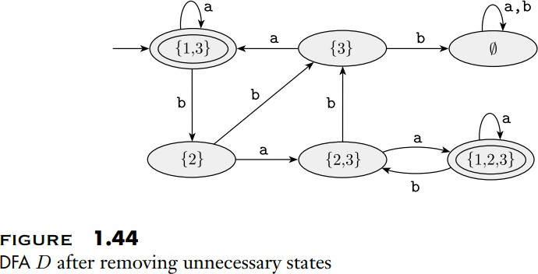
Removing Unnecessary States
Lecturer Saifur Rahman, Dept. of CSE, United International University

Slide 54
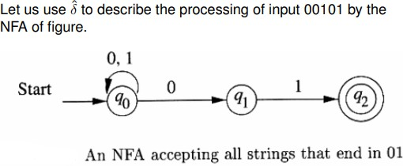
The Extended Transition Function
As for DFA’s, we need to extend the transition function δ of an NFA to a function δˆ that
takes a state q and a string of input symbols w,
and returns the set of states that the NFA is in if it starts in state q and processes the string w.
Lecturer Saifur Rahman, Dept. of CSE, United International University

Slide 55
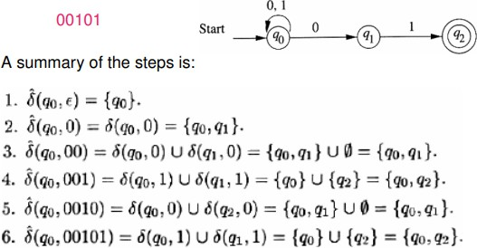
The Extended Transition Function - continued
Lecturer Saifur Rahman, Dept. of CSE, United International University

